Slide 1
Experiment No. 3
Problem Definition: a) Develop and demonstrate, using JavaScript script, a XHTML document that contains three short paragraphs of text, stacked on top of each other, with only enough of each showing so that the mouse cursor can be placed over some part of them. When the cursor is placed over the exposed part of any paragraph, it should rise to the top to become completely visible.
b) Modify the above document so that when a paragraph is moved from the top stacking position, it returns to its original position rather than to the bottom
CSE@GIT
6/1/2017
Department of Computer Science and Engineering, GIT

Slide 2
Objectives of the Experiment:
To demonstrate the use of CSS
To develop an understanding of tags in Z-index
To be able to build stacking of elements
CSE@GIT
6/1/2017
Department of Computer Science and Engineering, GIT

Slide 3
Introduction
Cascading Style Sheets (CSS) is a stylesheet language used to describe the presentation of a document written in HTML
CSS describes how elements should be rendered on screen
The CSS1 specification was developed in 1996
CSS2 was released in 1998
CSS2.1 is a recommendation
CSS3 is the latest evolution
CSSs provide the means to control and change presentation of HTML documents
CSS is not technically HTML, but can be embedded in HTML documents
Department of Computer Science and Engineering, GIT

Slide 4
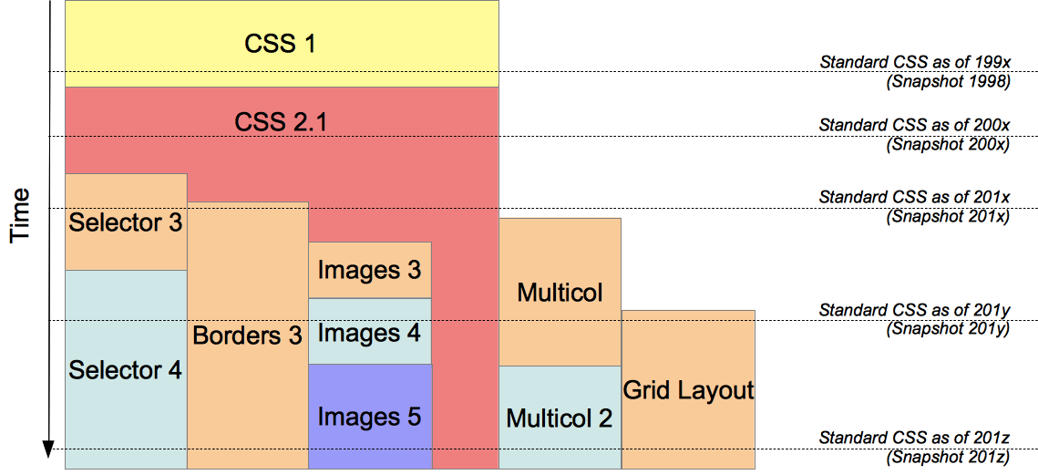
Introduction
[https://mdn.mozillademos.org/files/3623/CSS_Modules_and_Snapshots.png]
Department of Computer Science and Engineering, GIT

Slide 5

Introduction
CSS can be embedded in HTML documents
Style sheets allow you to impose a standard style on a whole document, or even a whole collection of documents
Style is specified for a tag by the values of its properties
Department of Computer Science and Engineering, GIT

Slide 6
Levels of Style Sheets
There are three levels of style sheets
Inline - specified for a specific occurrence of a tag and apply only to that tag
This is fine-grain style, which defeats the purpose of style sheets - uniform style
Document-level style sheets - apply to the whole document in which they appear
External style sheets - can be applied to any number of documents
When more than one style sheet applies to a specific tag in a document, the lowest level style sheet has precedence
Browser searches for a style property spec, starting with inline, until it finds one (or there isn’t one)
Department of Computer Science and Engineering, GIT

Slide 7
Levels of Style Sheets
Inline style sheets appear in the tag itself
Document-level style sheets appear in the head of the document
External style sheets are in separate files, potentially on any server on the Internet
Written as text files with the MIME type text/css
Department of Computer Science and Engineering, GIT

Slide 8
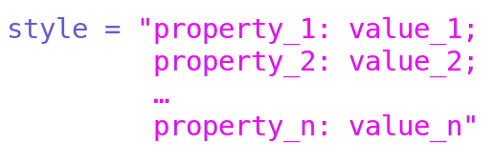
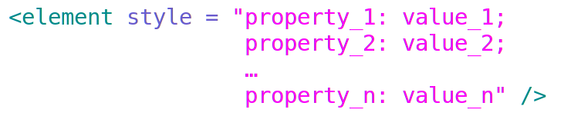
Style Specification Formats
Format depends on the level of the style sheet
Inline:
Style sheet appears as the value of the style attribute
General form: as attribute value pair
Department of Computer Science and Engineering, GIT

Slide 9
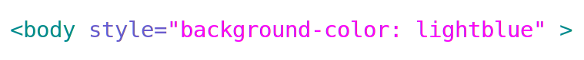
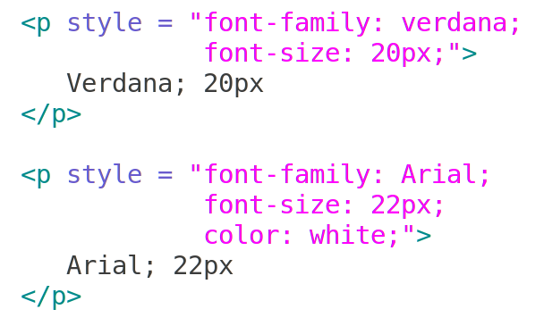
Style Specification Formats
Example :
Department of Computer Science and Engineering, GIT

Slide 10
Format for Document-level
Style sheet appears as a list of rules that are the content of a <style> tag
The <style> tag must include the type attribute, set to "text/css"
The list of rules must be placed in an HTML comment, because it is not HTML
Comments in the rule list must have a different form - use C comments (/*…*/)
Department of Computer Science and Engineering, GIT

Slide 11
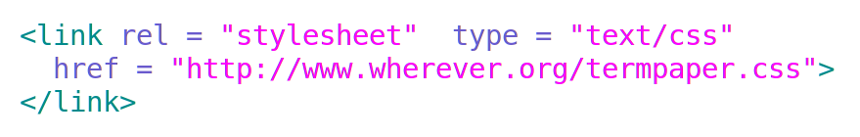
Linking an External Stylesheet
A <link> tag is used to specify that the browser is to fetch and use an external style sheet file
External style sheets can be validated
https://jigsaw.w3.org/css-validator/
Department of Computer Science and Engineering, GIT

Slide 12
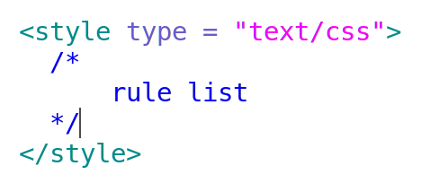
General Form, Document Level
General form:
Form of the rules:
selector { list of property/values}
Each property/value pair has the form:
property:value
Pairs are separated by semicolons ;
Department of Computer Science and Engineering, GIT

Slide 13
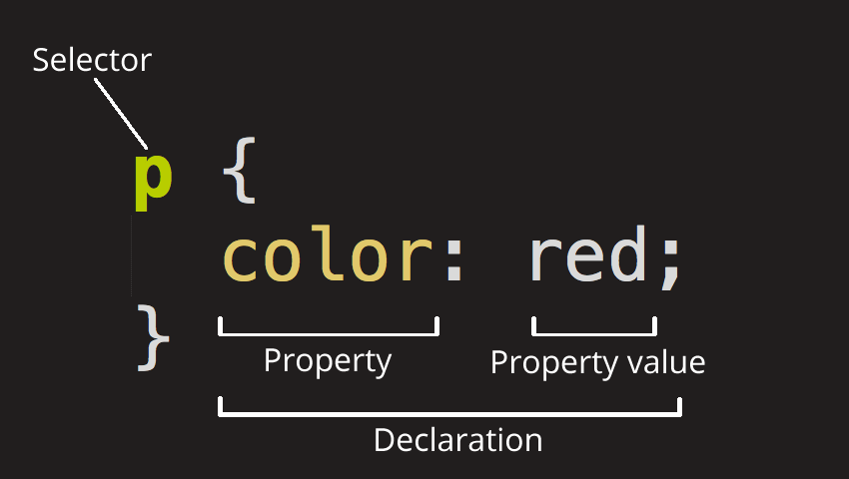
Format for Document-level
Example : to select all the paragraph elements on an HTML page and turn the text within them red, you'd write this CSS:
[ https://developer.mozilla.org/en-US/docs/Learn/Getting_started_with_the_web/CSS_basics ]
Department of Computer Science and Engineering, GIT

Slide 14
Format for Document-level
Example : to select all the paragraph elements on an HTML page and turn the text within them red, you'd write this CSS:
Selector - HTML element name at the start of the rule set
It selects the element(s) to be styled (in this case, p elements)
To style a different element, just change the selector
[ https://developer.mozilla.org/en-US/docs/Learn/Getting_started_with_the_web/CSS_basics ]
Department of Computer Science and Engineering, GIT

Slide 15
Format for Document-level
Example : to select all the paragraph elements on an HTML page and turn the text within them red, you'd write this CSS:
Declaration - single rule like color: red; specifying which of the element's properties you want to style
[ https://developer.mozilla.org/en-US/docs/Learn/Getting_started_with_the_web/CSS_basics ]
Department of Computer Science and Engineering, GIT

Slide 16
Format for Document-level
Properties - Ways in which you can style a given HTML element - this case, color is a property of the <p> elements
You choose which properties you want to affect in your rule
Property value - To the right of the property after the colon, we have the property value, which chooses one out of many possible appearances for a given property
There are many color values besides red
[ https://developer.mozilla.org/en-US/docs/Learn/Getting_started_with_the_web/CSS_basics ]
Department of Computer Science and Engineering, GIT

Slide 17
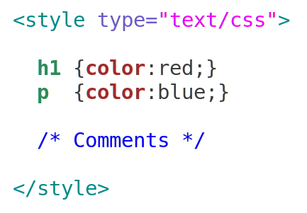
Format for Document-level
Example :
Department of Computer Science and Engineering, GIT

Slide 18
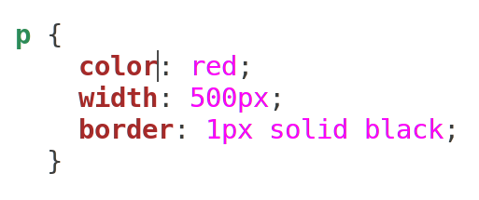
Important parts of the syntax
Each rule set (apart from the selector) must be wrapped in curly braces {}
Within each declaration, you must use a colon : to separate the property from its values
Within each rule set, you must use a semicolon ; to separate each declaration from the next one
Department of Computer Science and Engineering, GIT

Slide 19
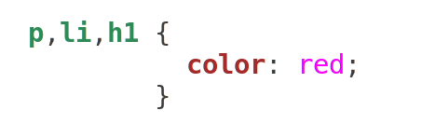
Selector Forms: Simple
The selector is a tag name or a list of tag names, separated by commas , example of tag names :
h1
h3
p
Selecting multiple elements – select multiple types of elements and apply a single rule set to all of them
Include multiple selectors separated by commas
Department of Computer Science and Engineering, GIT

Slide 20
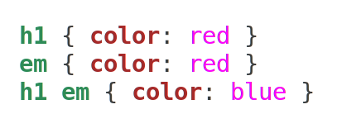
Selector Forms: Simple
The selector is a tag name or a list of tag names, separated by commas , example of tag names :
h1
h3
p
Contextual selectors - Context is defined as an ancestor/descendent relationship between elements in the document tree
Example – apply style only to those em elements that are contained by an h1 element
Department of Computer Science and Engineering, GIT

Slide 21
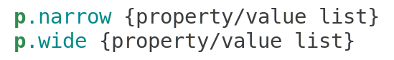
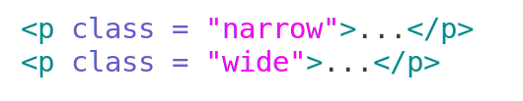
Class Selectors
Used to allow different occurrences of the same tag to use different style specifications
A style class has a name, which is attached to a tag name
The class you want on a particular occurrence of a tag is specified with the class attribute of the tag
For example,
Department of Computer Science and Engineering, GIT

Slide 22
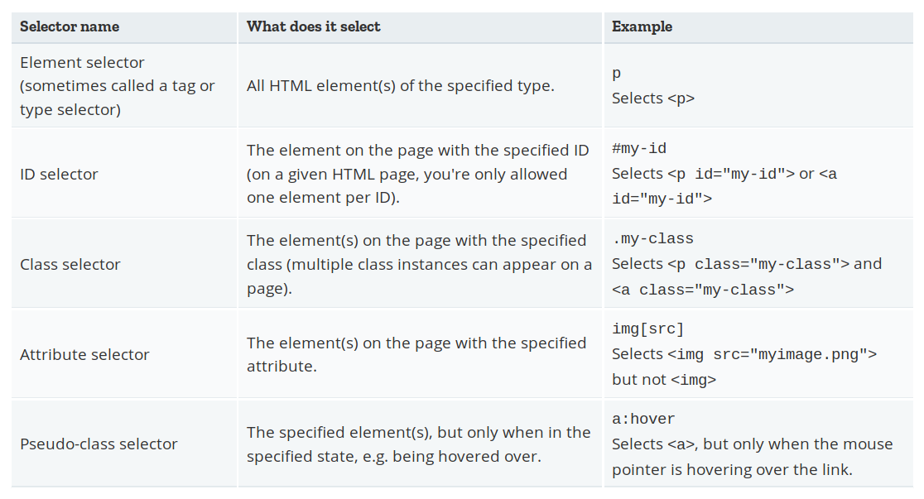
Different types of selector
[ https://developer.mozilla.org/en-US/docs/Learn/Getting_started_with_the_web/CSS_basics ]
Department of Computer Science and Engineering, GIT

Slide 23
Document Object Model
The Document Object Model (DOM) connects web pages to scripts or programming languages
DOM model represents a document with a logical tree
Each branch of the tree ends in a node, and each node contains objects
DOM methods allow programmatic access to the tree; with them you can change the document's structure, style or content
Nodes can have event handlers attached to them
Once an event is triggered, the event handlers get execute
[ https://developer.mozilla.org/en-US/docs/Web/API/Document_Object_Model ]
Department of Computer Science and Engineering, GIT

Slide 24
Document Object Model
DOM specifications describe an abstract model of a document
Interfaces describe methods and properties, tree structure
Different languages will bind the interfaces to specific implementations
The internal representation may not be tree-like
In JavaScript, data are represented as properties and operations as methods
DOM is an object-oriented representation of the web page, which can be modified with a scripting language such as JavaScript
Department of Computer Science and Engineering, GIT

Slide 25
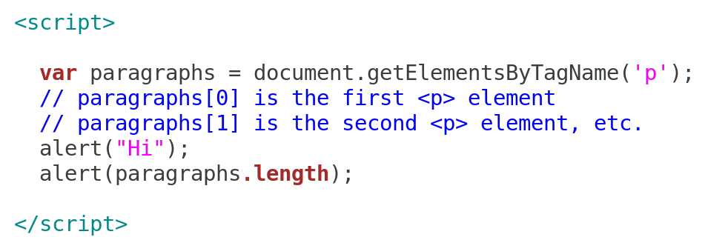
Document Object Model
Example : standard DOM specifies that the method : getElementsByTagName in the code below must return a list of all the <p> elements/tags in the document
[ https://developer.mozilla.org/en-US/docs/Web/API/Document_Object_Model/Introduction ]
Department of Computer Science and Engineering, GIT

Slide 26
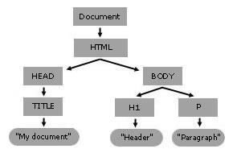
Document Object Model
When Mozilla parses a document, it builds a content tree and then uses it to display the document
[ https://developer.mozilla.org/en-US/docs/Web/API/Document_object_model/Using_the_W3C_DOM_Level_1_Core ]
Department of Computer Science and Engineering, GIT

Slide 27
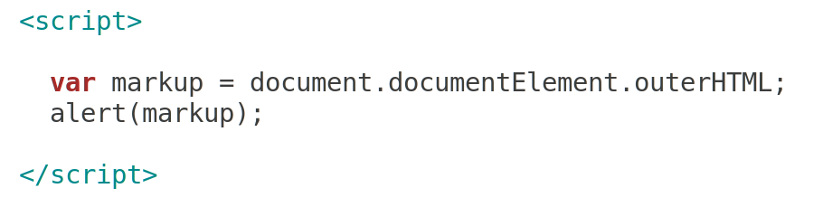
Document Object Model
Suppose the script was palced in head tag, then what will be displayed by alert?
Suppose same script was placed in body tag, then?
[ https://developer.mozilla.org/en-US/docs/Web/API/Element/outerHTML ]
Department of Computer Science and Engineering, GIT

Slide 28
Document Object Model Levels
DOM Levels
DOM 0: informal, early browsers
DOM 1: XHMTL/XML structure
DOM 2: event model, style interface, traversal
DOM 3: content model, validation
[ https://www.w3.org/DOM/ , https://developer.mozilla.org/fr/docs/DOM_Levels ]
Department of Computer Science and Engineering, GIT

Slide 29
Document Object Model Levels
If you want to utilize full power of DOM, DOM builds succcessfully only for structured document, hence
For each start tag – there should be close/end tag
Nest properly
Case sensitive, <head> is different than <HEAD>
Use "" to enclose Attribute values
Department of Computer Science and Engineering, GIT

Slide 30
Document Object Model Levels – Level 1
DOM Level 1 specification is separated into two parts:
Core and
HTML
Core Level 1 provides a low-level set of fundamental interfaces that can represent any structured document (example XML document)
HTML Level 1 provides additional, higher-level interfaces that are used with interfaces defined in Core Level 1 to provide a more convenient view of an HTML document
Interfaces introduced in DOM1 include Document, Node, Attr, Element, and Text interfaces
All interfaces contain attributes and/or methods that can be used to interact with XML and HTML documents
Department of Computer Science and Engineering, GIT

Slide 31
Document Object Model Levels – Level 2
DOM Level 2 has six different specifications:
DOM2 Core
Views
Events
Style
Traversal and Range
DOM2 HTML
Department of Computer Science and Engineering, GIT

Slide 32
Document Object Model Levels – Level 2
DOM Level 2 has six different specifications:
DOM2 Core :
extends the functionality of the DOM1 Core
Contains specialized interfaces dedicated to XML
Introduces getElementById
Views
Allows programs and scripts to dynamically access and update the content of a representation of a document
Interfaces are AbstractView and DocumentView
Events
Style
Traversal and Range
DOM2 HTML
Department of Computer Science and Engineering, GIT

Slide 33
Document Object Model Levels – Level 2
DOM Level 2 has six different specifications:
DOM2 Core
Views
Events : Interfaces make your life easier when dealing with events, Generic event system to programs and script
addEventListener , handleEvent
EventListener, DocumentEvent, MouseEvent
Does not include an interface for the keyboard events, which is in later versions of the DOM
Style
Traversal and Range
DOM2 HTML
Department of Computer Science and Engineering, GIT

Slide 34
Document Object Model Levels – Level 2
DOM Level 2 has six different specifications:
DOM2 Core
Views
Events
Style : CSS, allows programs and scripts to dynamically access and update the content of style sheets
interfaces for Style Sheets : getComputedStyle
Traversal and Range : allow programs and scripts to dynamically traverse and identify a range of content in a document
interfaces like NodeIterator and TreeWalker
DOM2 HTML
Department of Computer Science and Engineering, GIT

Slide 35
Document Object Model Levels – Level 2
DOM Level 2 has six different specifications:
DOM2 Core
Views
Events
Style
Traversal and Range
DOM2 HTML : allows programs and scripts to dynamically access and update the content and structure of HTML documents
Extends the interfaces defined in the DOM1 HTML, using the DOM2 Core possibilities
Department of Computer Science and Engineering, GIT

Slide 36
Document Object Model Levels – Level 3
DOM Level 3 contains five different specifications:
DOM3 Core
Load and Save
Validation
Events
Xpath
[ https://developer.mozilla.org/fr/docs/DOM_Levels , Author: Fabian Guisset ]
Department of Computer Science and Engineering, GIT

Slide 37
Document Object Model Levels – Level 3
DOM Level 3 contains five different specifications:
DOM3 Core : extend the functionality of the DOM1 and DOM2 Core specs
methods and properties like adoptNode() and textContent
Load and Save : allows programs and scripts to dynamically load the content of an XML document into a DOM document, and serialize a DOM document into an XML document
Validation
Events
Xpath
[ https://developer.mozilla.org/fr/docs/DOM_Levels , Author: Fabian Guisset ]
Department of Computer Science and Engineering, GIT

Slide 38
Document Object Model Levels – Level 3
DOM Level 3 contains five different specifications:
DOM3 Core
Load and Save
Validation : allows programs and scripts to dynamically update the content and the structure of documents while ensuring that the document remains valid, or to ensure that the document becomes valid
Events : extension of the DOM2 Events specification, keyboard events and how to handle them
Xpath : provides simple functionalities to access a DOM tree using XPath 1.0.
[ https://developer.mozilla.org/fr/docs/DOM_Levels , Author: Fabian Guisset ]
Department of Computer Science and Engineering, GIT

Slide 39
Events and Event Handling
Event-driven programming is a style of programming in which pieces of code, event handlers, are written to be activated when certain events occur
Events represent activity in the environment including, especially, user actions such as moving the mouse or typing on the keyboard
Events are fired inside the browser window, and tend to be attached to a specific item that resides in it
Might be a single element or set , HTML document loaded in the current tab, or the entire browser window
Department of Computer Science and Engineering, GIT

Slide 40
Events and Event Handling
Examples of events :
The user clicking the mouse over a certain element, or hovering the cursor over a certain element
The user pressing a key on the keyboard
The user resizing or closing the browser window
A web page finishing loading
A form being submitted
A video being played, or paused, or finishing play
An error occuring
[ https://developer.mozilla.org/en-US/docs/Learn/JavaScript/Building_blocks/Events ]
Department of Computer Science and Engineering, GIT

Slide 41
Events and Event Handling
Each event has an event handler, which is block of code (usually a user-defined JavaScript function) that will be run when the event fires
Events are represented by JavaScript objects
When such a block of code is defined to be run in response to an event firing, we say we are registering an event handler
Event handlers are sometimes called event listeners
Assign an event attribute an event handler
Assign a DOM node an event handler
Department of Computer Science and Engineering, GIT

Slide 42
Events, Attributes and Tags
Event Tag Attribute
blur onblur
change onchange
click onclick
focus onfocus
load onload
mousedown onmousedown
mousemove onmousemove
mouseout onmouseout
mouseover onmouseover
mouseup onmouseup
select onselect
submit onsubmit
unload onunload
Department of Computer Science and Engineering, GIT

Slide 43
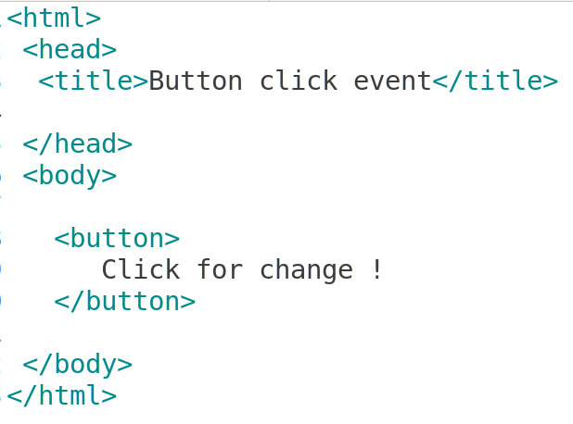
Events and Event Handling
What will be displayed ?
Department of Computer Science and Engineering, GIT

Slide 44
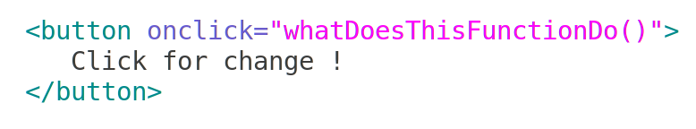
Events and Event Handling
Following changes are made to button, now what will happen ?
Department of Computer Science and Engineering, GIT

Slide 45
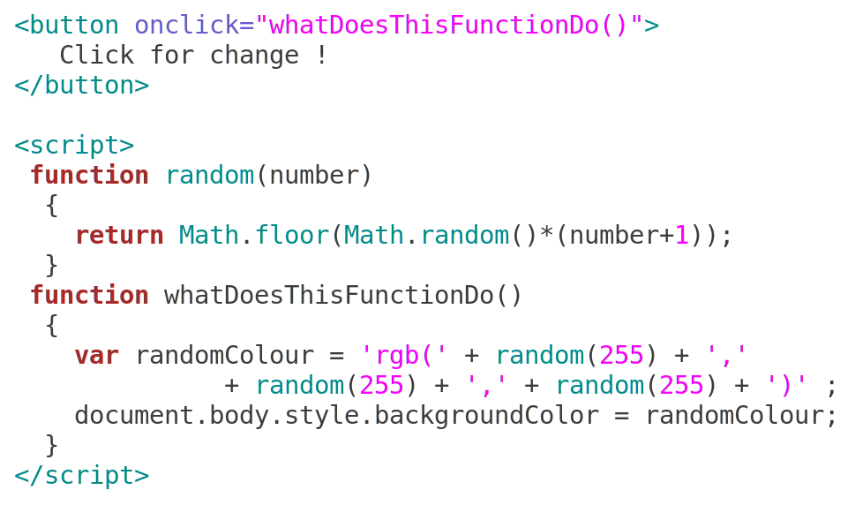
Events and Event Handling
And if the function call is :
Department of Computer Science and Engineering, GIT

Slide 46
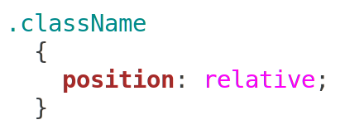
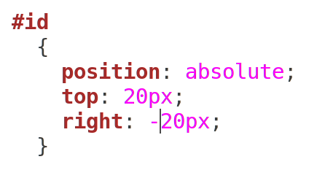
Element Positioning
CSS provides tools to position elements in a web page
Property position specifies the position mode
Value is absolute, relative or static
Properties left, right, top and bottom specify element position
Department of Computer Science and Engineering, GIT

Slide 47
Element Positioning
A positive value of top pushes the element down
A positive value of left pushes the element to the right
A negative value of top pushes the element up
A negative value of left pushes the element to the left
Absolute position specifies where an element appears relative to the containing element
Final location of positioned elements is determine based on position and values of top or bottom, and left or right
[ CSS basics - Learn web development | MDN : https://developer.mozilla.org/en-US/docs/Learn/Getting_started_with_the_web/CSS_basics
position - CSS | MDN :
https://developer.mozilla.org/en-US/docs/Web/CSS/position ]
Department of Computer Science and Engineering, GIT

Slide 48
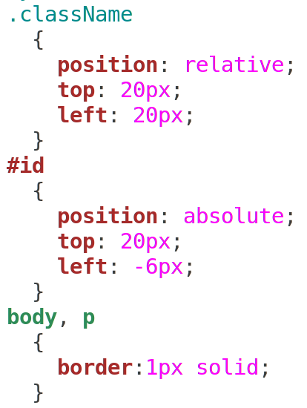
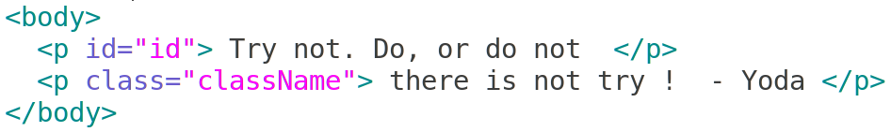
Absolute and Relative Positioning
Department of Computer Science and Engineering, GIT

Slide 49
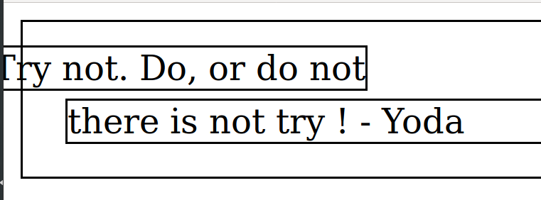
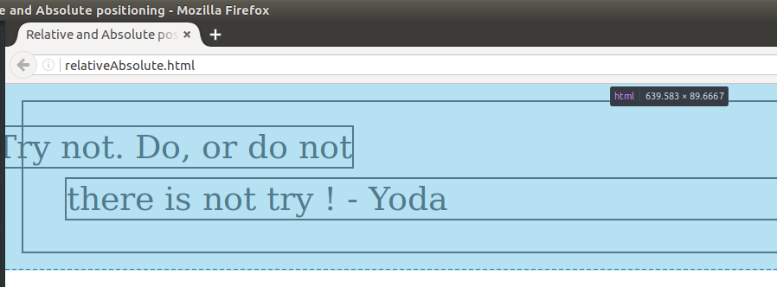
Absolute / Relative Positioning
Department of Computer Science and Engineering, GIT

Slide 50
Stacking Elements
Property = z-index
The z-index style property can be used to govern the layering of elements in the display
If two elements both cover a part of the window, the element with the higher z-index value will cover the other one
Think of a artist painting the document content on the screen.
Elements with lower z-index are painted before those with higher z-index
Manipulating the z-index property dynamically
Absolute position specifies where an element appears relative to the containing element
Department of Computer Science and Engineering, GIT

Slide 51
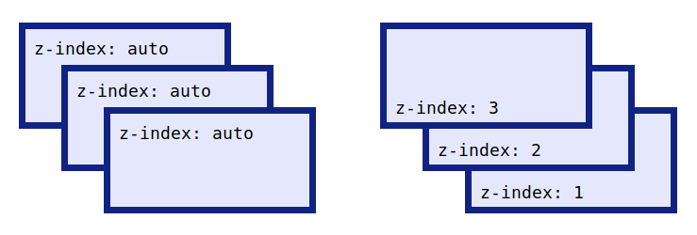
Stacking Elements
Effect of z-index
On the left three boxes have been overlaped using absolute positioning
By default, the elements are stacked following the order they're declared in the HTML
On the right the same markup, but have reversed the default order using z-index property and assigning values
[ https://developer.mozilla.org/en-US/docs/Web/CSS/z-index ]
Department of Computer Science and Engineering, GIT

Slide 52
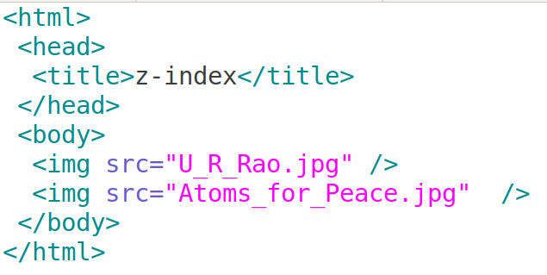
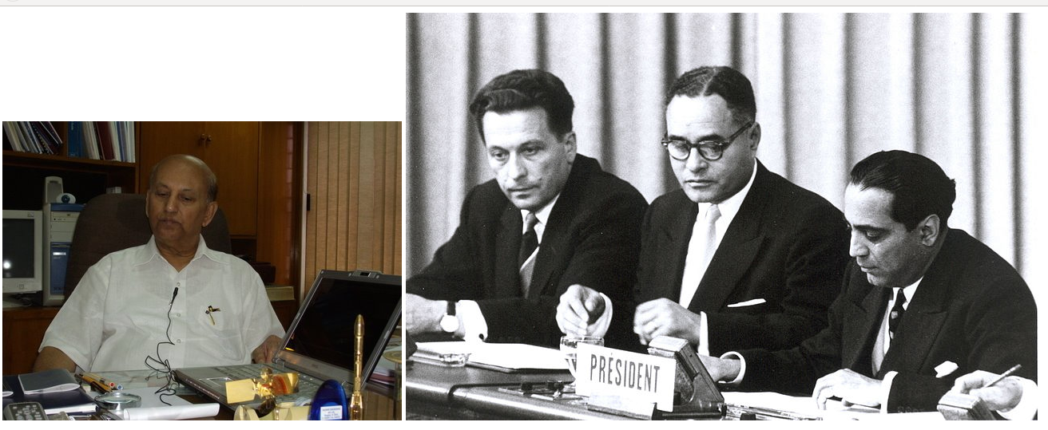
Z-Index
[ Author HPNadig ] [ Author IAEA Imagebank ]
Department of Computer Science and Engineering, GIT

Slide 53
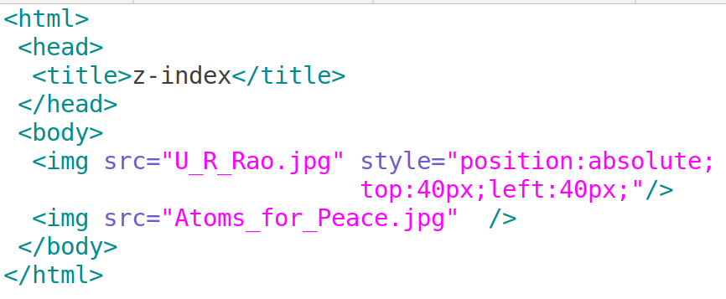

Z-Index
Department of Computer Science and Engineering, GIT

Slide 54
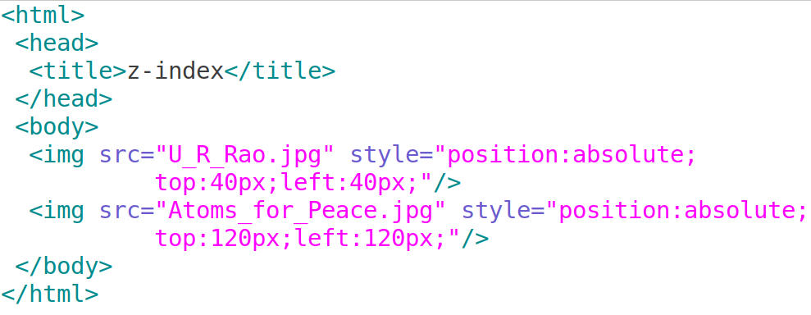

Z-Index
Department of Computer Science and Engineering, GIT

Slide 55
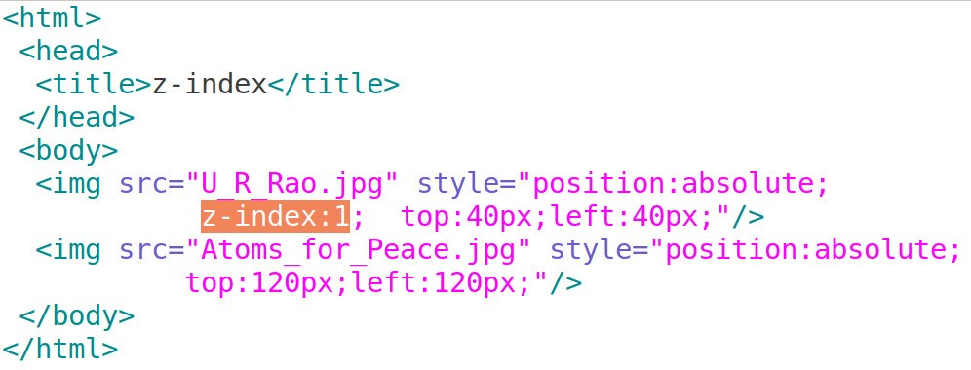
Z-Index
Department of Computer Science and Engineering, GIT

Slide 56
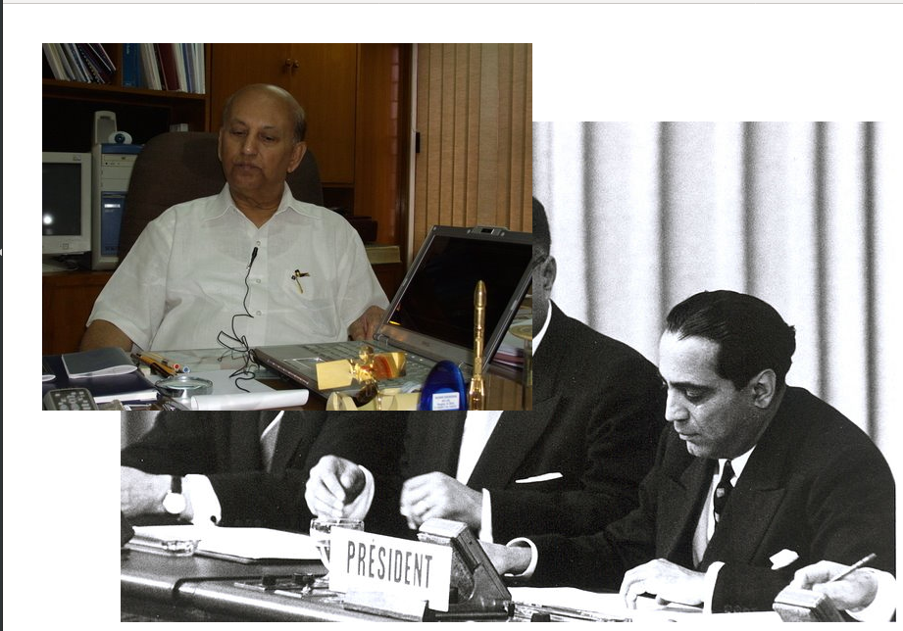
Z-Index
Department of Computer Science and Engineering, GIT

Slide 57
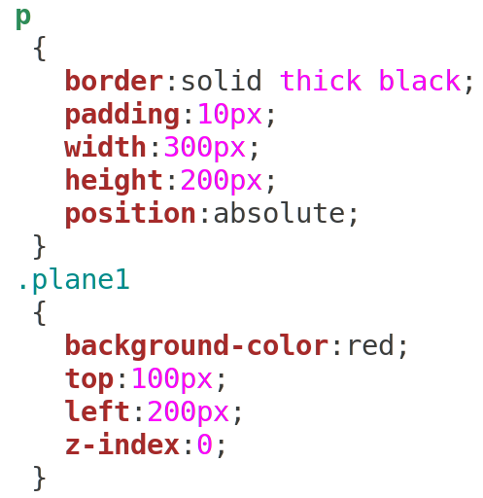
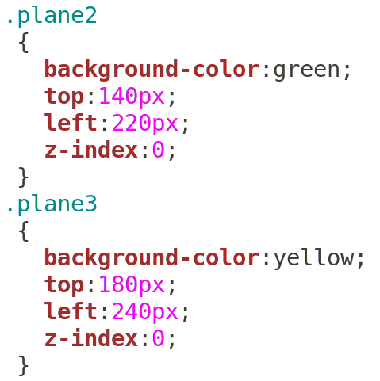
3a. Pseudo Code / Outline of the Algorithm
Department of Computer Science and Engineering, GIT

Slide 58
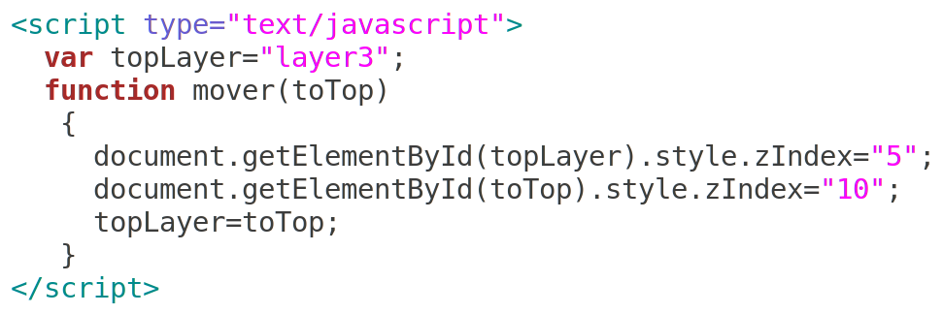
3a. Pseudo Code / Outline of the Algorithm
Department of Computer Science and Engineering, GIT

Slide 59
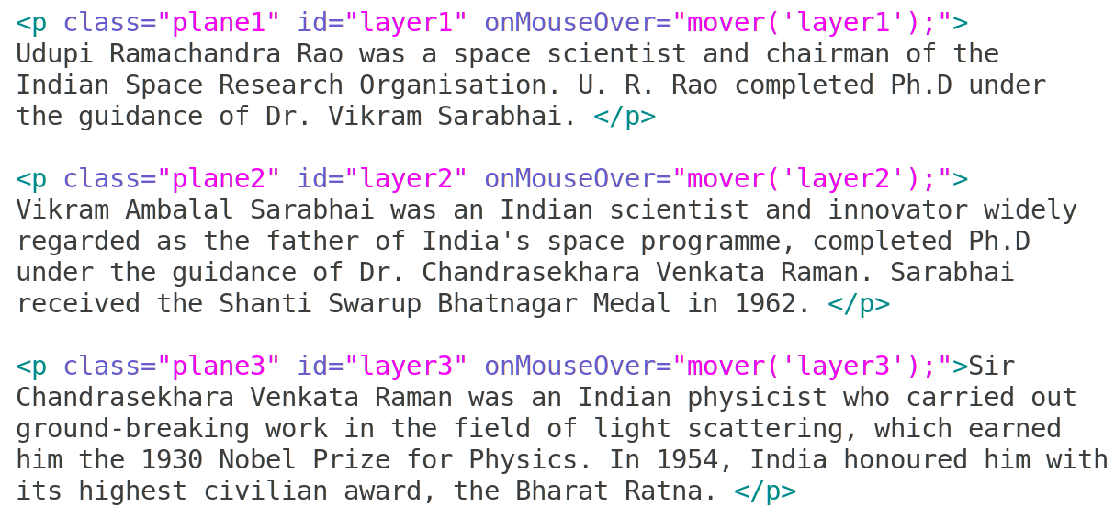
3a. Pseudo Code / Outline of the Algorithm
Department of Computer Science and Engineering, GIT

Slide 60
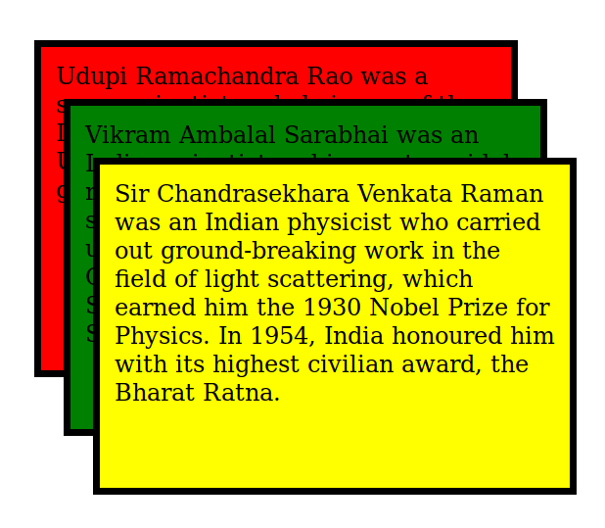
Sample Run
Department of Computer Science and Engineering, GIT

Slide 61
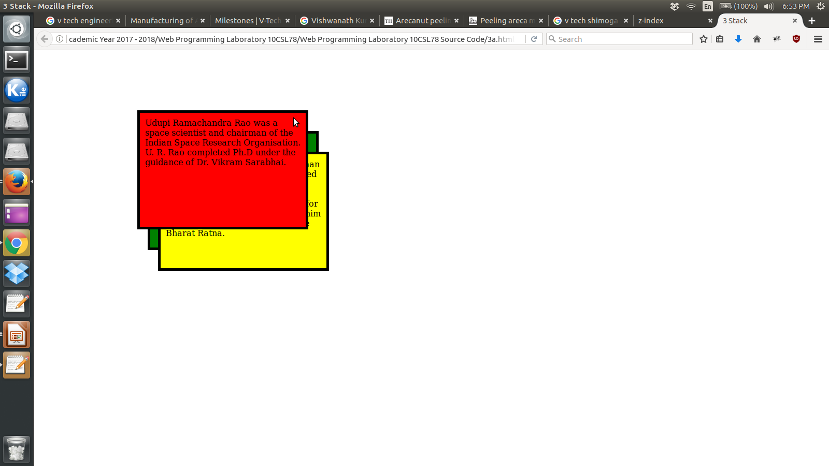
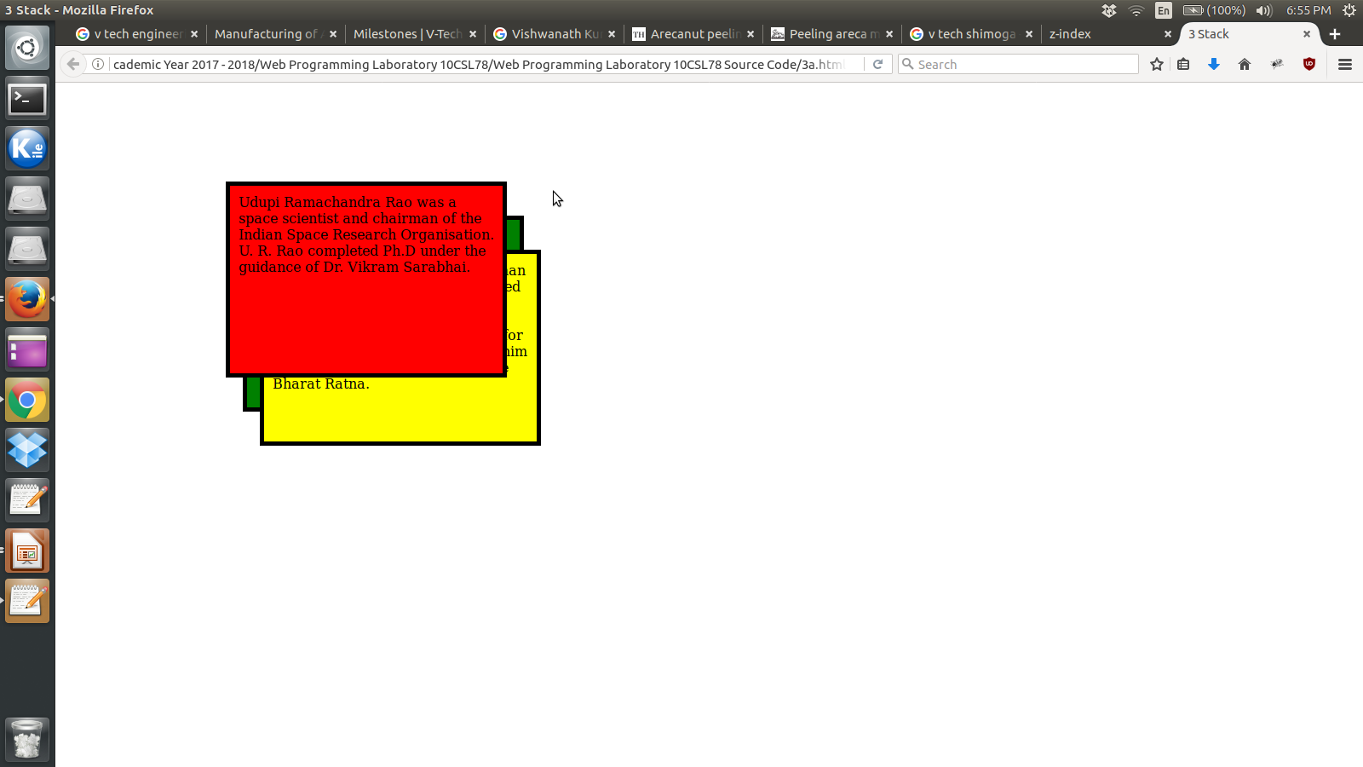
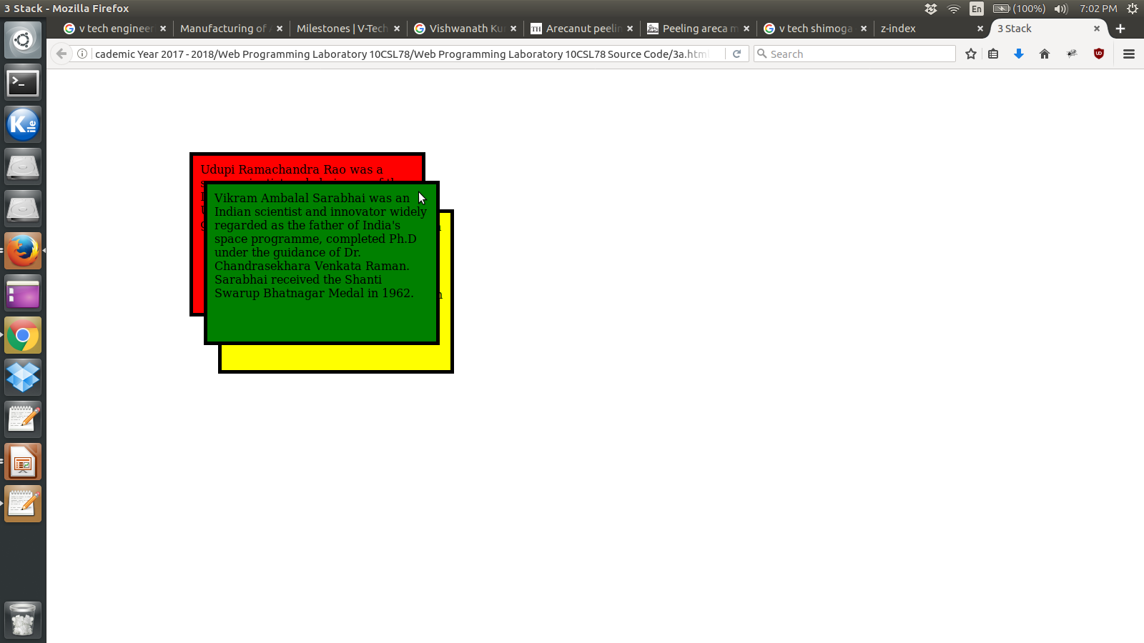

Sample Run
Department of Computer Science and Engineering, GIT

Slide 62
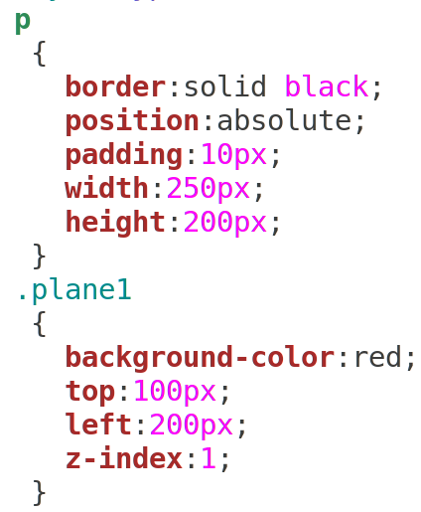
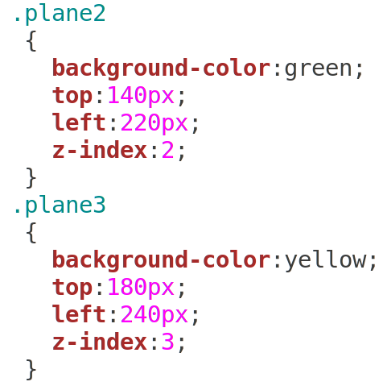
3b. Pseudo Code / Outline of the Algorithm
Department of Computer Science and Engineering, GIT

Slide 63
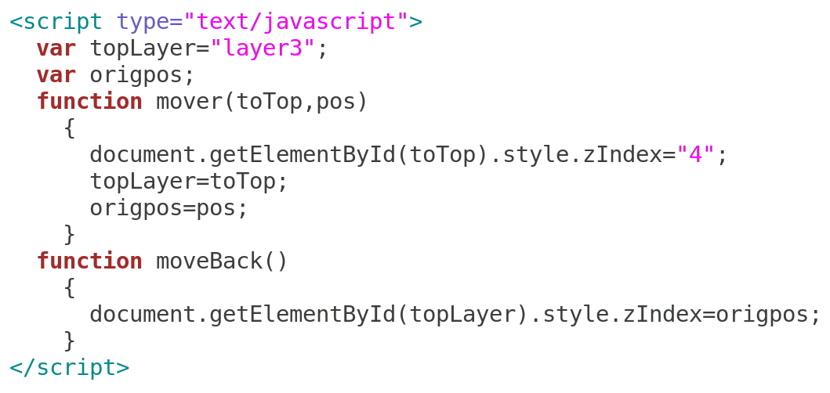
3b. Pseudo Code / Outline of the Algorithm
Department of Computer Science and Engineering, GIT

Slide 64
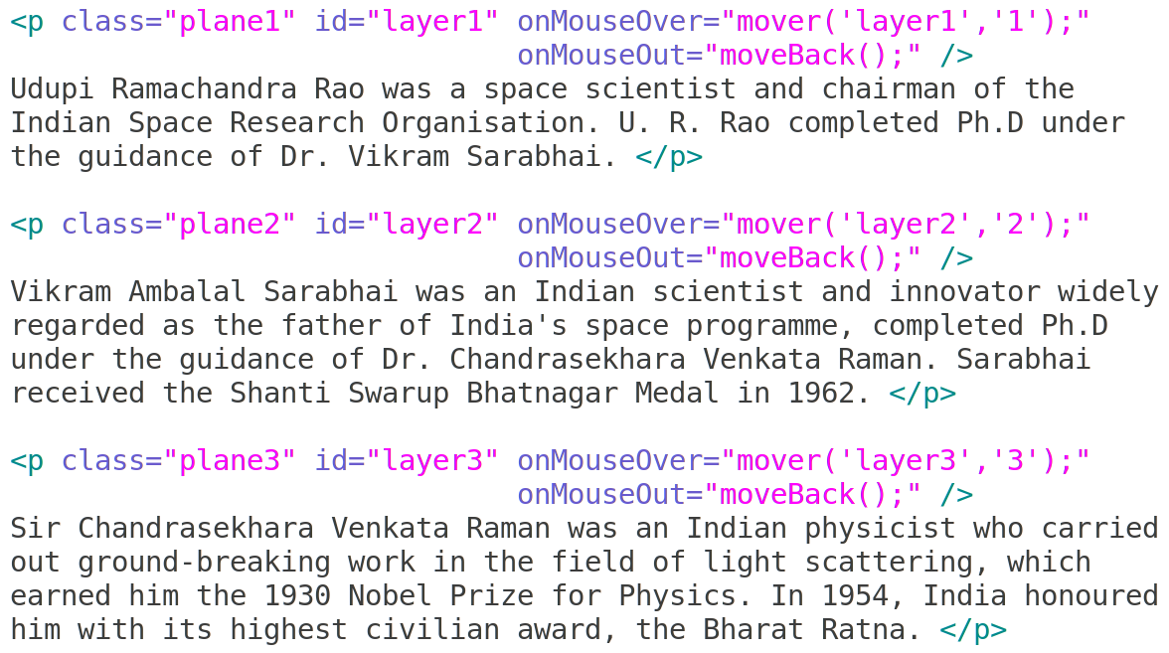
3b. Pseudo Code / Outline of the Algorithm
Department of Computer Science and Engineering, GIT

Slide 65
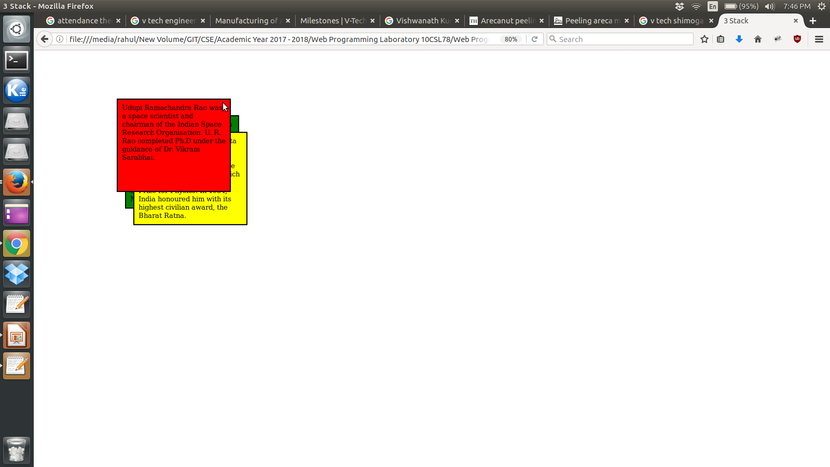
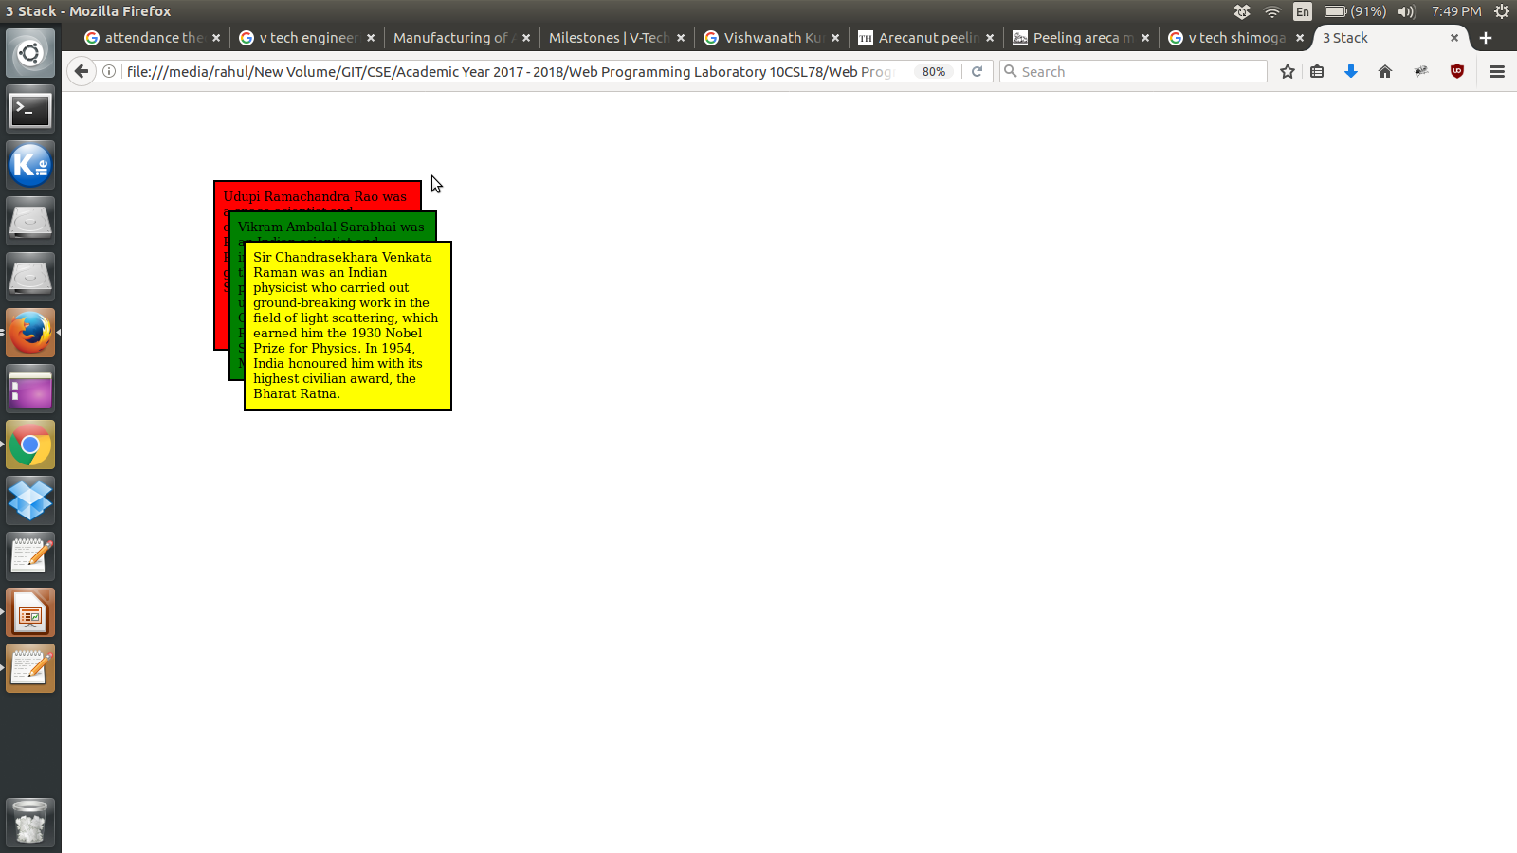
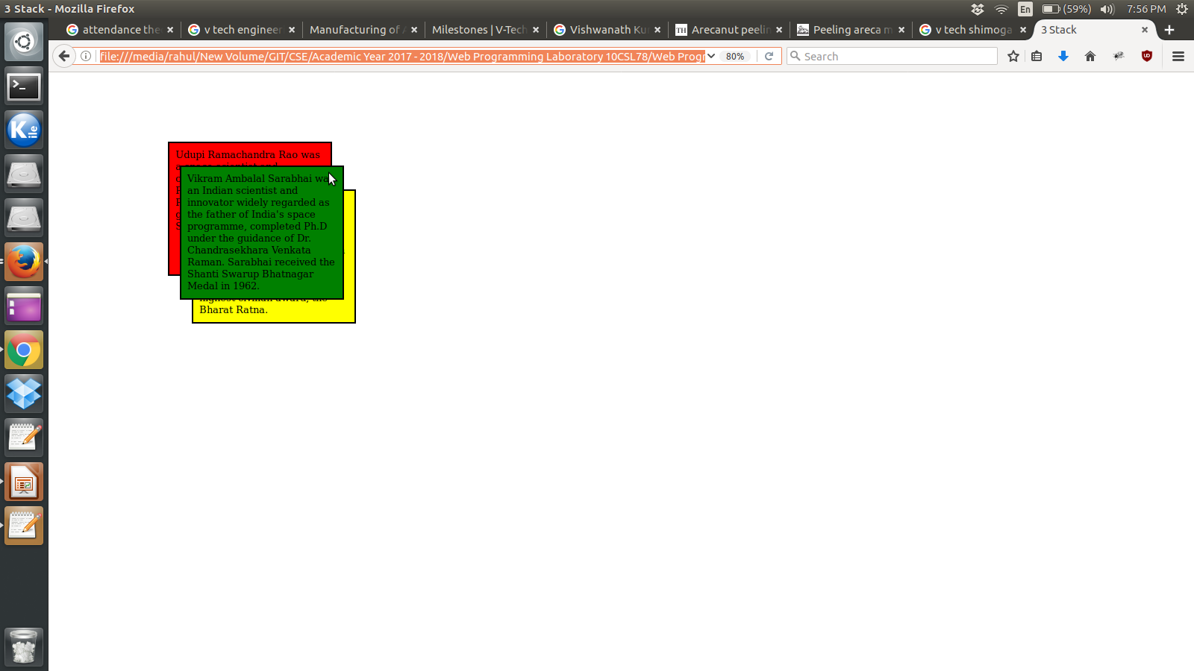
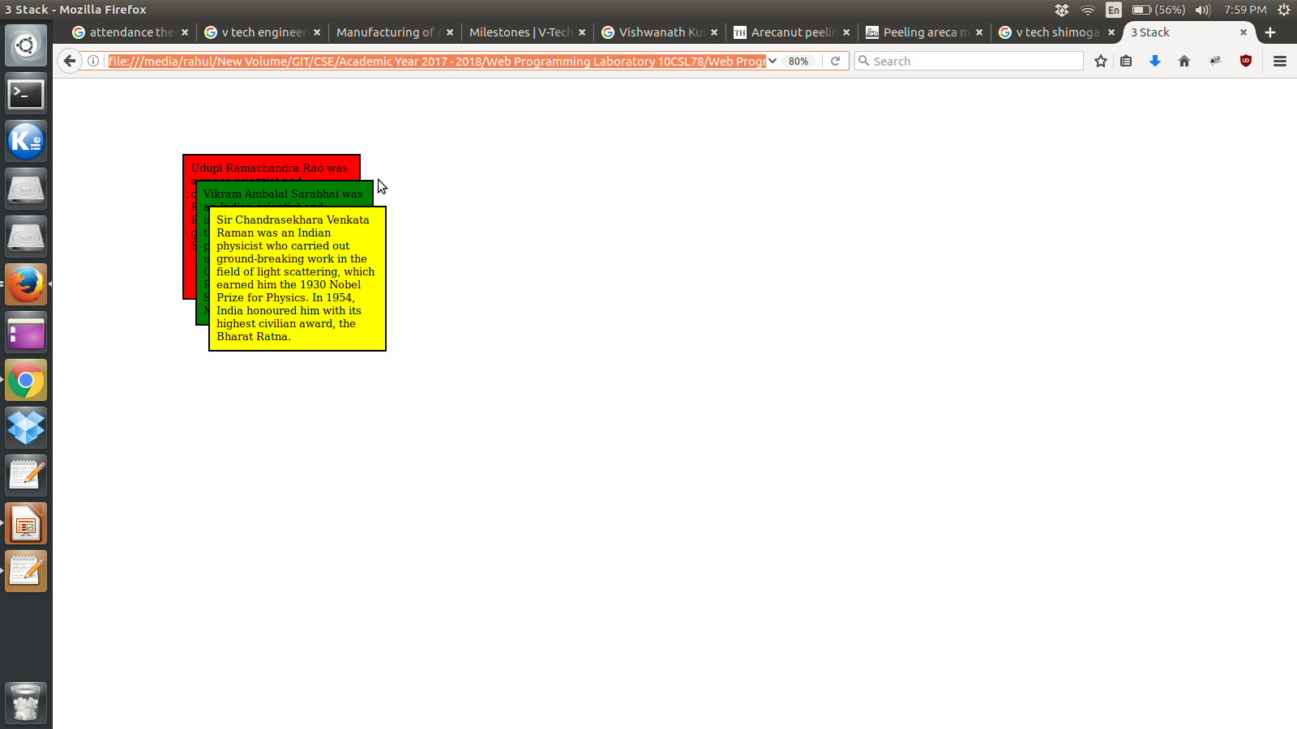
Sample Run
Department of Computer Science and Engineering, GIT

Slide 66
Learning Outcomes of the Experiment
At the end of the session, students should be able to :
1)
2)
Department of Computer Science and Engineering, GIT

